Slide 1

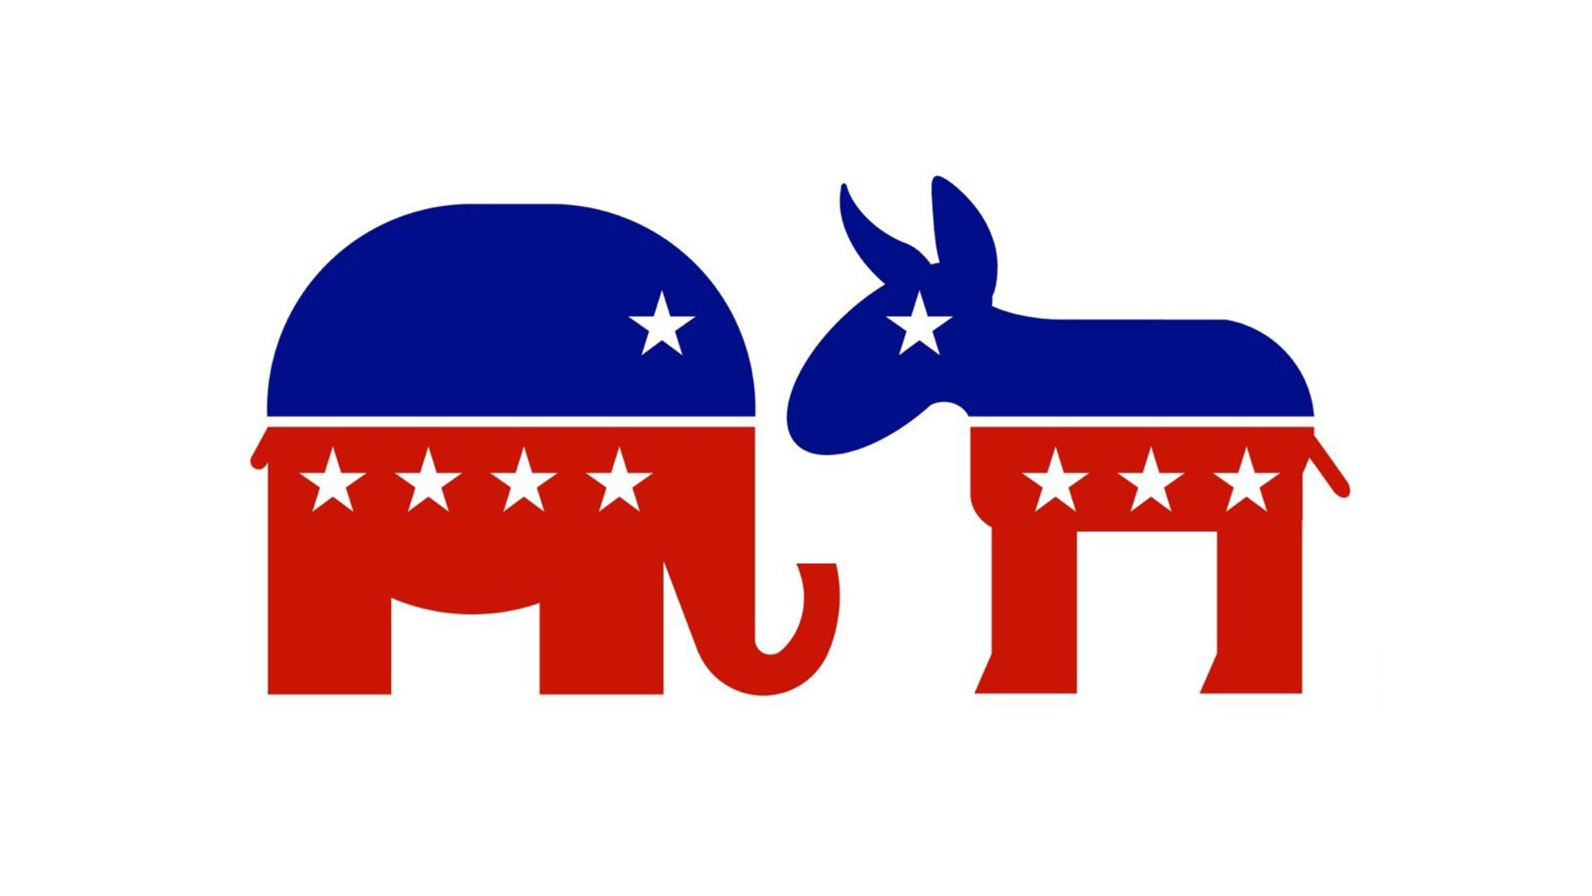
Election Results Analysis
By Shoshana Gilg
Data 205 CRN 22017

Slide 2
Election Results Analysis
Overview: This project analyzes the 2020 General Election, focusing on the state of Maryland. Key demographic insights and voter behavior patterns, including turnout and voting methods, are explored.
Purpose: To uncover trends in voter demographics and turnout, providing a deeper understanding of electoral participation and its influencing factors.

Slide 3
Tools and Methods
Tools Used:
Programming Language: Python
Libraries:
pandas: For data manipulation and analysis.
matplotlib & plotly: For creating visualizations.
folium: For mapping and geospatial visualizations (used in census data analysis).
numpy: For numerical operations.
os, urllib, and json: For handling file operations and API data integration.
Methods:
Data Cleaning:
Stripped whitespace and standardized column names.
Combined datasets for comprehensive analysis.
Visualization:
Used matplotlib and plotly for trend analysis and interactive plots.
Mapped demographic distributions using folium.
Statistical Analysis:
Computed voter turnout percentages and demographic breakdowns.
API Integration:
Accessed external data sources for supplementary insights.

Slide 4
Information on the Data Set
Data | Source | Description
Federal Elections 2020 | Federal Election Commission | Includes state-level results with fields such as candidate names, parties, general results (vote counts), and electoral votes.
Data Files for the 2020 Presidential General Election Results | Maryland State Board of Elections | Provides the 2020 Presidential General election in Maryland it includes county state results, how the voters voted in the election and who they voted for.
2020 Census API | The U.S. Census Bureau | The U.S. Census Bureau’s 2020 data for Maryland provides insights into the state's demographic, social, and economic characteristics, focusing on total population, racial composition, and age distribution.
Data Files for the 2024 Presidential Primary Results | Maryland State Board of Elections | Provides the 2024 Presidential Primary election in Maryland it includes county, state results, how the voters voted in the election and who they voted for.

Slide 5
Data Cleaning and Pre-Processing
Key Steps Performed:
Standardizing Column Names:
Removed extra whitespace from column names to ensure consistency in data referencing.
Data Combination:
Merged datasets to create a unified structure for analysis.
Handling Missing Values:
Identified and handled any missing or inconsistent entries to improve data quality.
Formatting for Analysis:
Reformatted data types (e.g., dates, numerical fields) to align with analysis requirements.
Impact on Analysis:
Ensured datasets were consistent and ready for aggregation and statistical computations.
Enabled seamless use of visualizations and computations in Python libraries like pandas and matplotlib.

Slide 6
Agenda
Overview of the 2020 General Election
United States vs. Maryland Comparison
Demographic Analysis of Maryland
Gender Demographics by County
Racial Demographics: White vs. African American Population
Adult Population Distribution
Breakdown by County
Voter Turnout Insights
Key Trends and Statistics
Voting Methods
Comparison of Primary vs. General Elections

Slide 7
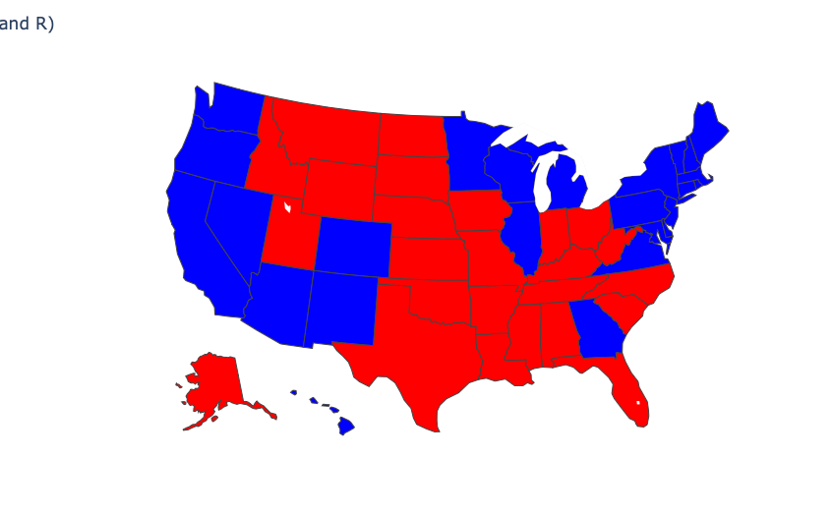
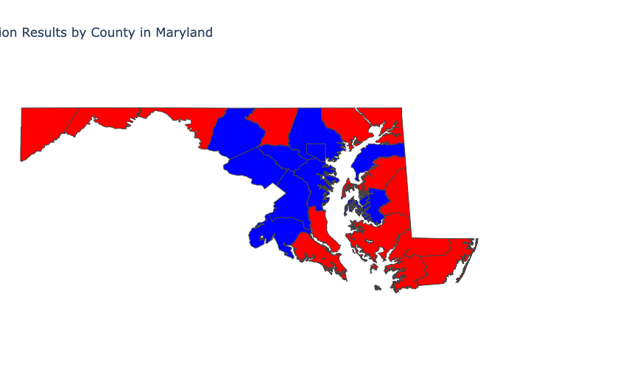
2020 General Election United States Vs. Maryland

Slide 8
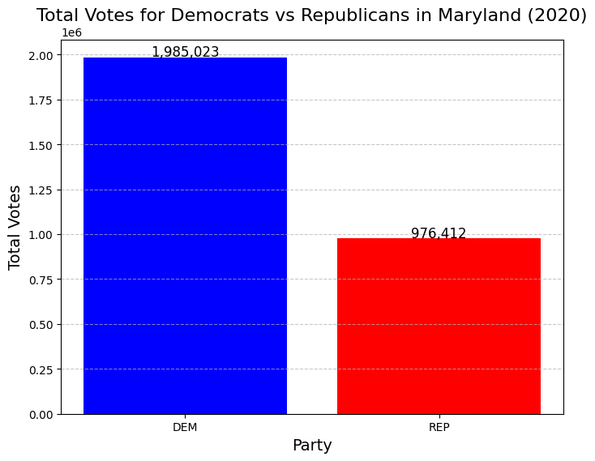
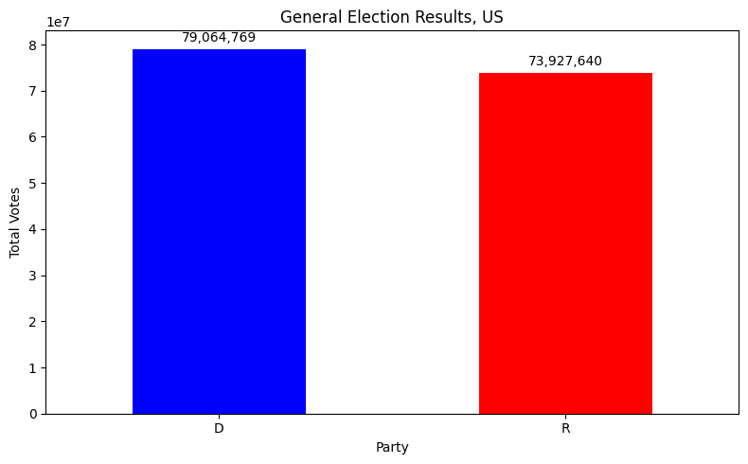
Nation Wide General Election VS Maryland

Slide 9
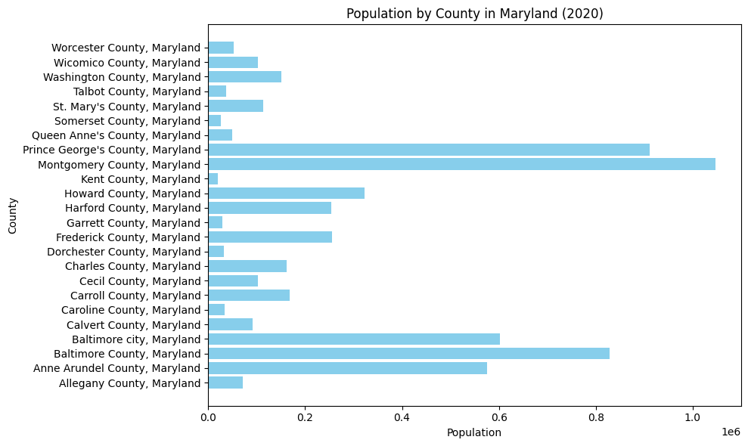
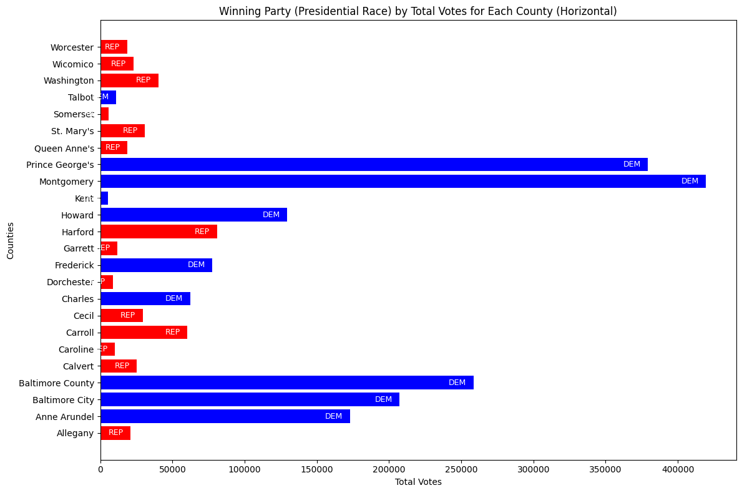
Demographics Vs. How Counties Voted

Slide 10
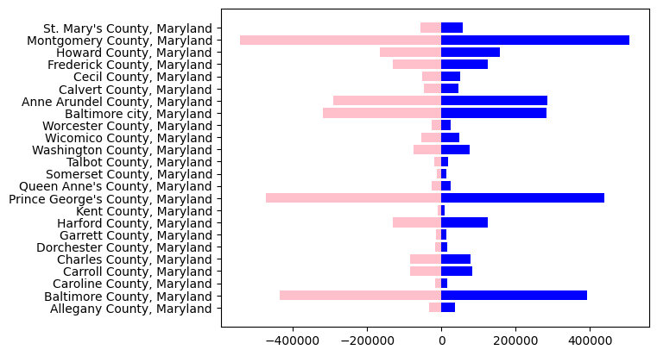




Gender Demographics of Maryland Counties

Slide 11
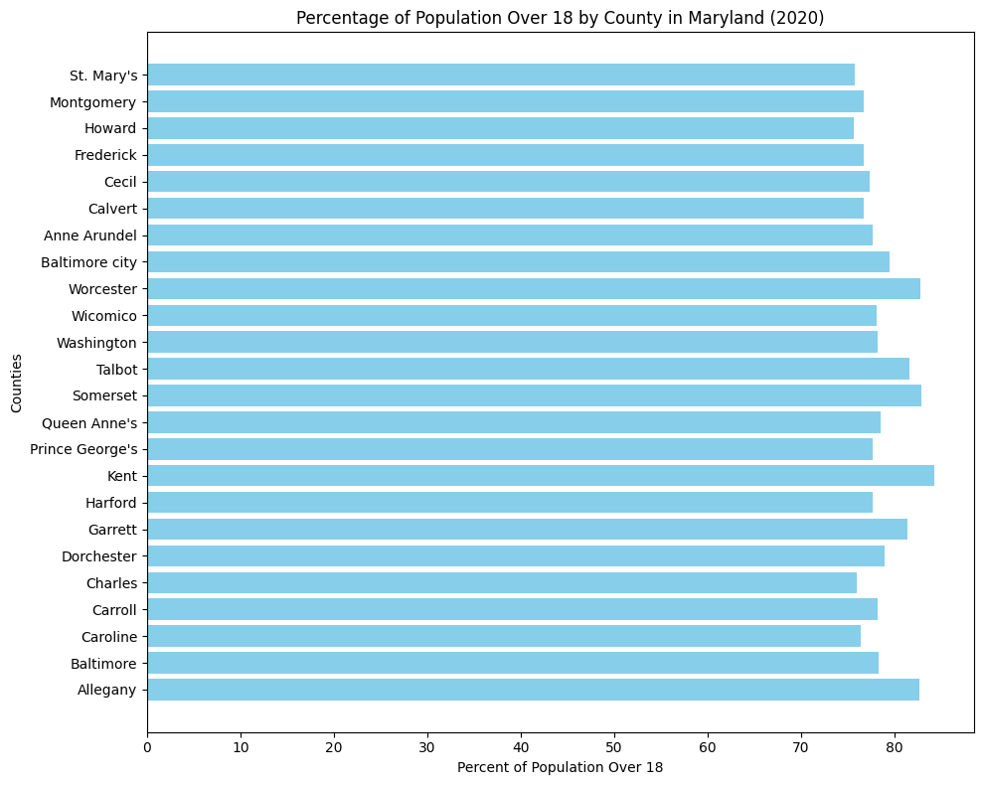
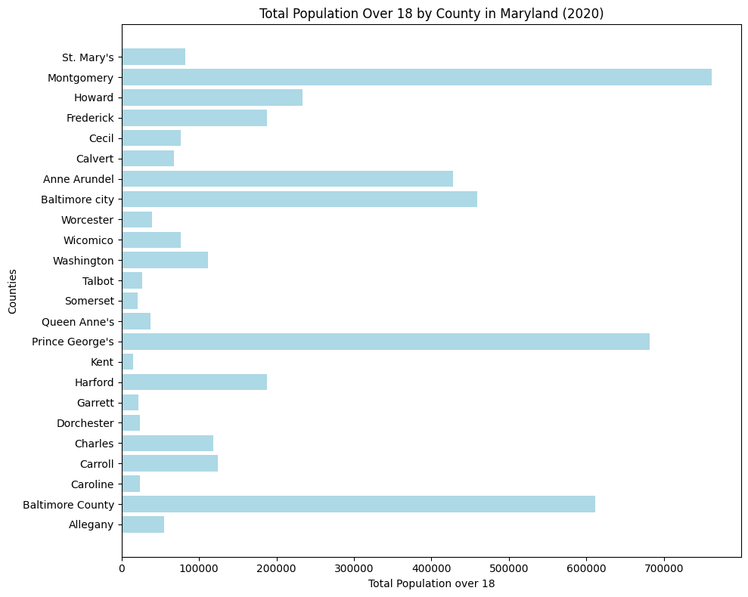
Adult Population By County

Slide 12
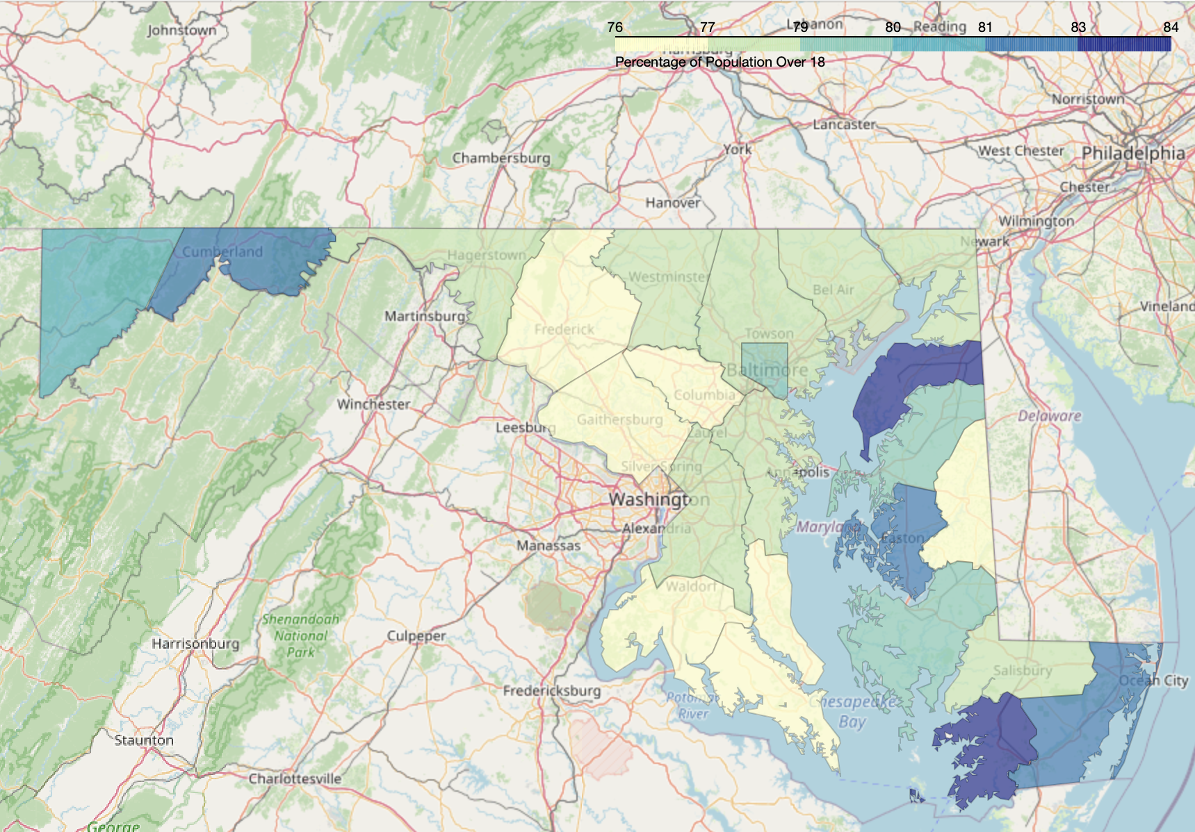

Slide 13
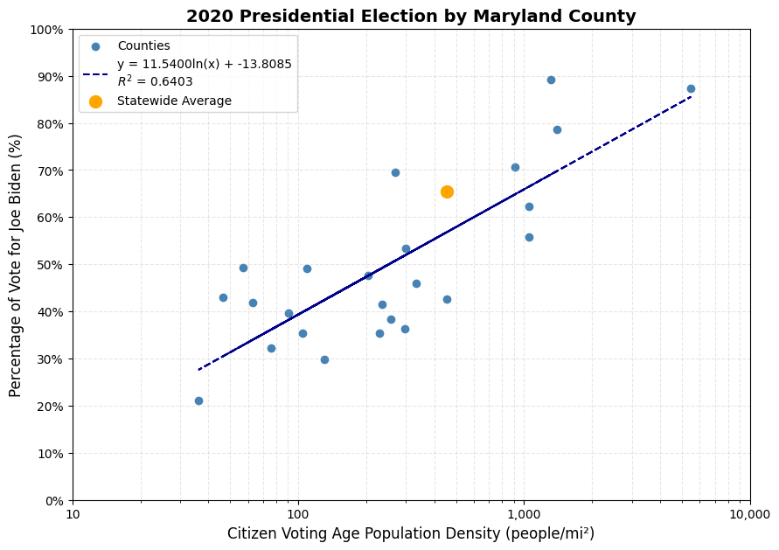

Slide 14
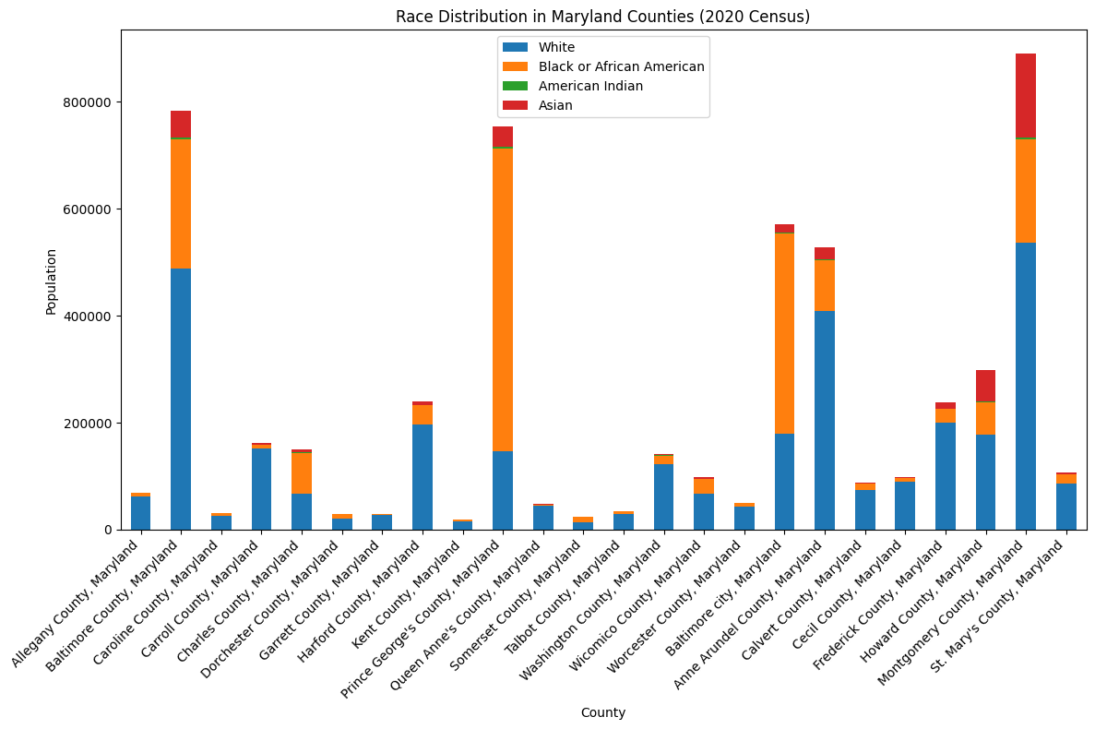

Slide 15
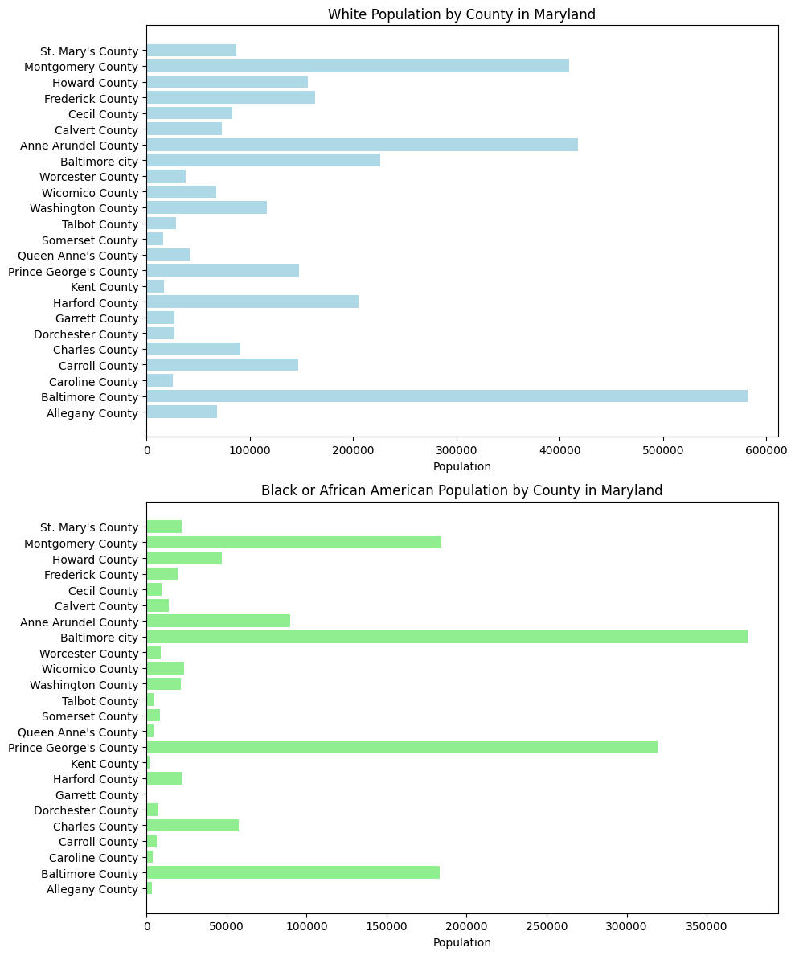
White Vs. African American Population

Slide 16
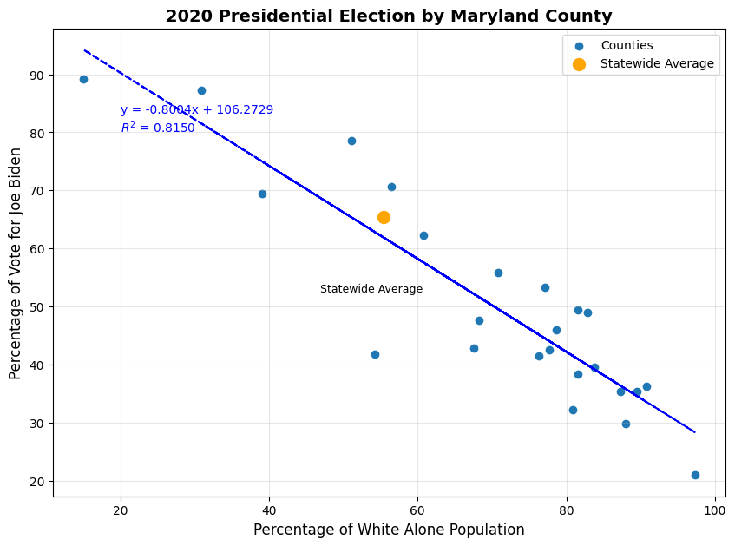

Slide 17
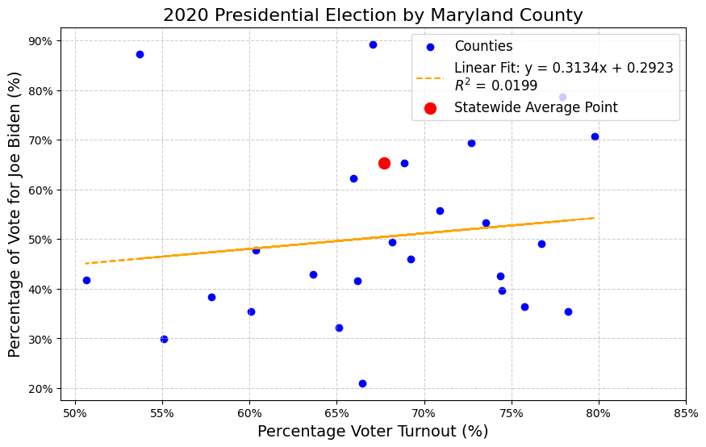
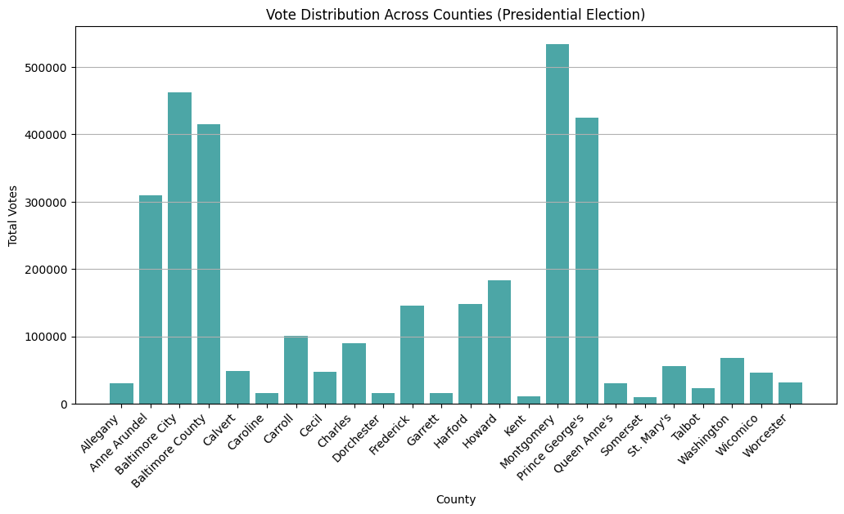
Voter Turnout

Slide 18
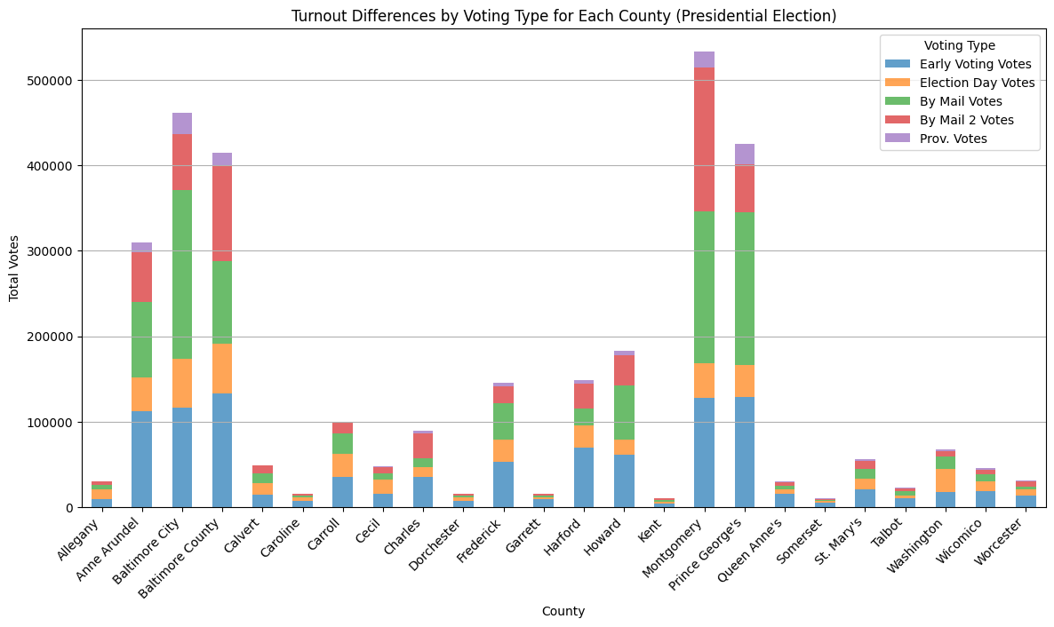
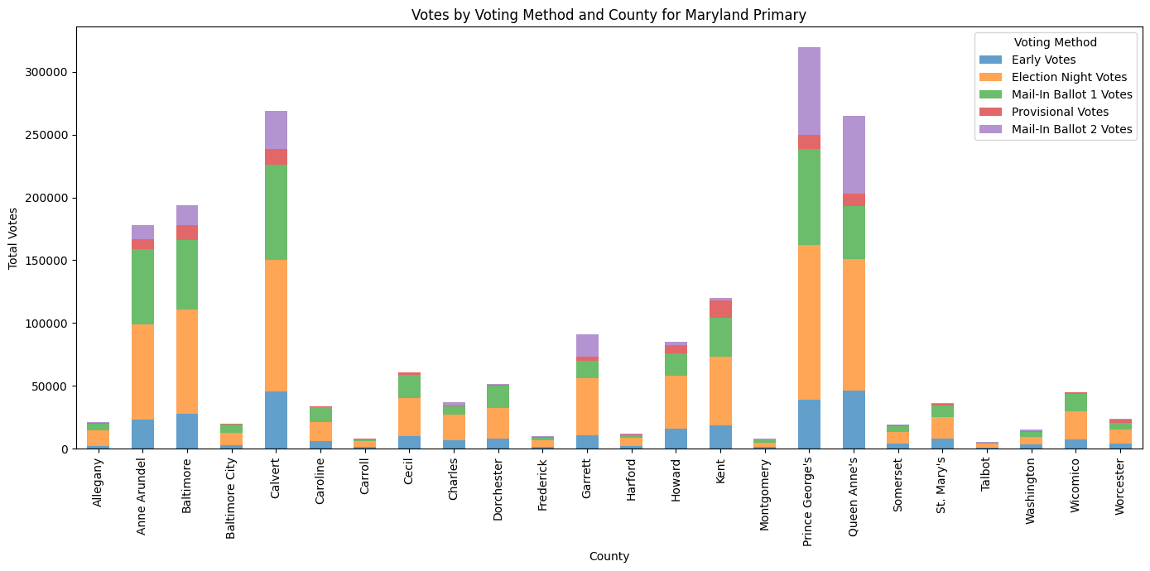
Voting Methods Primary Vs. General Election

Slide 19
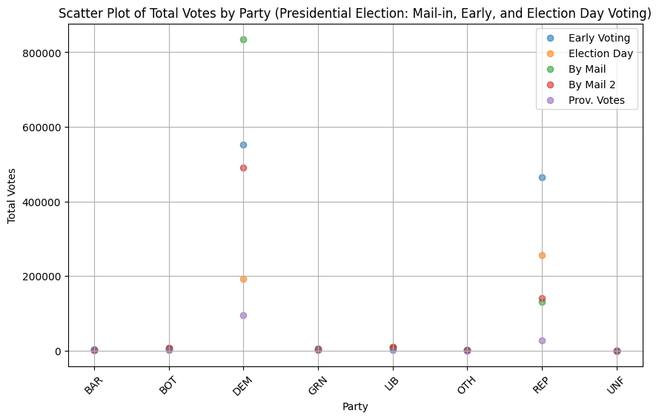
Voting Methods by Political Party

Slide 20
References & Acknowledgements
Data Sources:
Maryland State Board of Elections
United States Census Bureau
Federal Election Commission (FEC)
Project Advisor: Geoffrey Gilg
Acknowledgments: Special thanks to Geoffrey Gilg for his support and guidance throughout the development of this report.

